Slide 1
Christian Valley Park, Community Services District Speed Hump Pros, Cons, & Liability

Slide 2
Pros
Speeds reduced by ~10 mph
Self-enforcing
Effective long-term speed control without road redesign
Relatively low initial cost
Improved neighborhood safety for pedestrians

Slide 3
Cons
Potential vehicle damage or injury if crossed at high speed
Large emergency vehicles delayed up to 10 seconds per hump
Higher maintenance
Increased noise from braking, accelerating and compensatory speeding
Potentially reduced property values
May require supplemental lighting to avoid liability

Slide 4
Steps to Minimize Liability

Slide 5
Formal Engineering & Traffic Study
An engineering and traffic study documents baseline conditions, which is essential for justification and defense. This includes documenting:
Traffic volumes
85th percentile speeds
Crash/collision history
Pedestrian/bicycle activity
Road classification
Vehicles per day speeding >5 mph over limit

Slide 6
Verify Design Compliance
Follow Caltrans/CA MUTCD/FHWA standards:
Parabolic profile: 12 ft long, 3–4 in high
Spacing: 200–500 ft apart
Avoid steep grades (>6%), installation near intersections, and drainage issues
Consider alternatives (e.g., speed cushions) if emergency concerns high

Slide 7
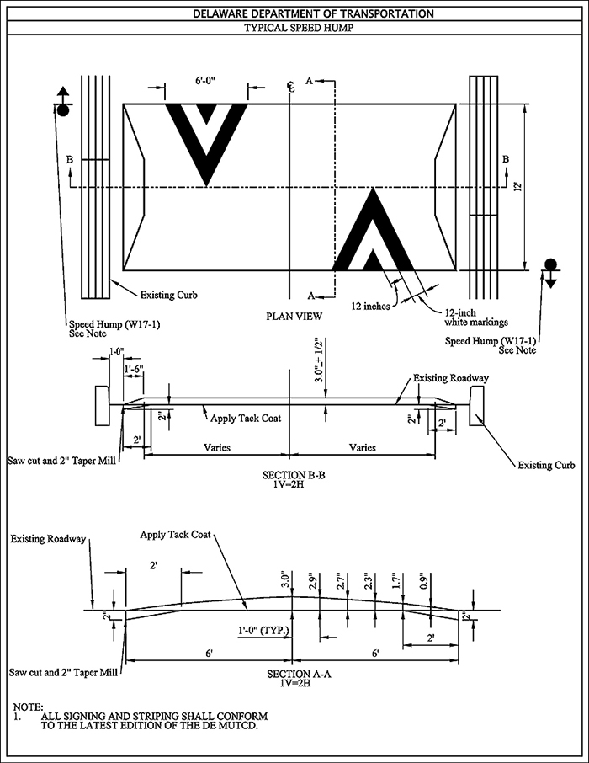
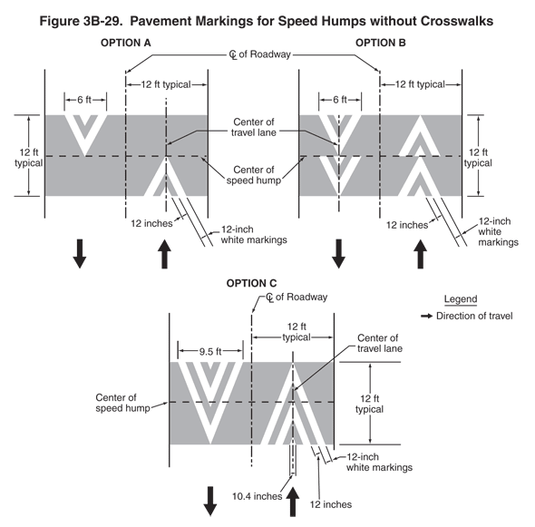

Slide 8
Early Stakeholder Consultation
Mandatory input from emergency services to assess response time impact
Petition residents to demonstrate public need and acceptance (67% resident approval is generally required)
Document all meetings, feedback, and resolutions

Slide 9
Signage, Markings & Visibility
CA MUTCD-requires:
Advance warning, which includes W17-1 "SPEED HUMP" sign
Advisory speed plaque
Pavement markings: White/yellow reflective striping and chevrons
Placement near lighting if possible

Slide 10
Engage Qualified Professionals Document Everything
Hire licensed engineers, contractors, and inspectors
Maintain comprehensive records, such as the Engineering & Traffic Survey
Consultation records, minutes, and emails
Design drawings and specifications
Approval resolutions
Photos of installation
Maintenance plan

Slide 11
Post-Installation Monitoring & Maintenance
Conduct before-and-after speed and crash evaluations
Regular inspections
Signage and striping refresh
Asphalt repairs
Prompt response to complaints
Update records annually

Slide 12
References
California Manual on Uniform Traffic Control Devices (CA MUTCD)
Caltrans Traffic Calming Guide
Placer County Neighborhood Traffic Management Program (NTMP)
FHWA (Federal Highway Administration) Traffic Calming ePrimer
ITE (Institute of Transportation Engineers) Guidelines for the Design and Application of Speed Humps
California Civil Code §1714 (California negligence law)

