Slide 1


CHRISTIAN VALLEY PARK
COMMUNITY SERVICES DISTRICT
Water Rate Study
Recommendations
Board Meeting
April 9, 2024
Alison Lechowicz
Project Manager

Slide 2
Background
  Water service is self-supported by water rates
  Other revenues include hookup fees, standby fees, and interest
  Gayle Loop property taxes pay off the Gayle Loop debt
Rate study will cover a 5-year period
  First rate increase effective July 1, 2024
  Subsequent increases will go into effect on July 1 of 2025, 2026, 2027, 2028
  Provides water service to 632 customers
  District purchases raw water from the Placer County Water Agency (PCWA) and receives water from the Bowman canal system

Slide 3
Current Quarterly Water Rates
Meter Size | Quarterly Service Charge
3/4" | $179.37
1" | $298.98
1-1/2" | $597.96
2" | $956.73
3" | $1,793.85
4" | $2,989.74
Usage Charge ($/ccf) | $1.28
1 ccf = 1 hundred cubic feet = 748 gallons

Slide 4
Example Bills – ¾” Single Family
  Fixed fee of $179.37 per quarter
  Plus water usage: $1.28 X ccf of use
Quarter |  | Average Water Use (ccf) | Quarterly Bill
1 | Jan through Mar | 25 | $211.37
2 | Apr through Jun | 64 | $261.29
3 | Jul through Sep | 109 | $318.89
4 | Oct through Dec | 39 | $229.29
 | Average | 59 | $254.89

Slide 5
Water Fund Financial Overview
Strong estimated reserves at end of FY2024 of about $927,000 of nonrestricted funds
Upcoming Cost of Service Increases
  Inflationary cost increases for most operating expenses
  Increase in water plant maintenance from $19,000 to $25,000
  $80,000 + inflation for annual water line repairs
  +$14,000/year set aside for the loan reserve requirement
  Up to +$45,000/year in high priority capital projects (media replacements, valve replacements, and professional services)
  Target a debt coverage ratio of 1.25x on existing debt obligations to maintain a strong credit rating
Potential additional needed funding of $1M of pipe replacements: Steel portion of the 8” Allen replacement and 6” Witt Road
Projected 2023/24 Financials

Slide 6
Rate Plan
23% increase July 1, 2024 to “course correct” the utility’s financials
  Meet operating and debt service costs
  Fund high priority valve replacements, media filters, pipeline breaks, and associated professional services costs over the next five years
  Increases to the fixed meter fees and usage rate
  No growth assumed
July 1, 2025 (i.e. year 2 of the rate plan)
  Add a fixed capital improvement fee
  Introducing the capital fee in year 2 helps phase-in rate design changes over two years and mitigate rate impacts
  The capital fee is intended to recover $125,000 per year over four years
  Total capital fee revenue of $500,000 through FY2029 is equal to half of the $1M of estimated pipeline replacement costs
  Absent these capital improvements, the District would likely face costly emergency repairs and service interruptions

Slide 7
Rate Plan Continued
July 1 of years 2025 to 2028
  The fixed and usage charges will be increased by the annual change in the Consumer Price Index (CPI), a common measure of inflation
  Minimum increase of 3% annually and a maximum increase of 10% (recommended for Prop 218 compliance so ratepayers know the potential high end of future charges)
  As inflation changes from year to year, the District’s cost of providing water service also increases such as the cost of chemicals, electricity, materials, and supplies
  The CPI increase is not intended to generate excess funds but instead keep up with actual costs to avoid future deficits

Slide 8
Quarterly Water Rates
Meter Size | Current | PROPOSED
 |  | July 1, 2024 | July 1, 2025 | July 1, 2026 | July 1, 2027 | July 1, 2028
BASE FIXED CHARGE PER QUARTER
3/4" | $179.37 | $217.52 | To be increased annually based on the % increase in the Consumer Price Index (CPI) or 3% whichever is greater up to a maximum of 10%
1" | $298.98 | $355.85
2" | $956.73 | $1,116.66
USAGE CHARGE (metered water use)
$ per ccf | $1.28 | $1.63 | To be increased annually based on the % increase in the Consumer Price Index (CPI) or 3% whichever is greater up to a maximum of 10%
+ ADDITIONAL CAPITAL IMPROVEMENT FEE PER QUARTER (fixed charge)
3/4" | NA | $0.00 | $48.90 | $48.90 | $48.90 | $48.90
1" | NA | $0.00 | $81.51 | $81.51 | $81.51 | $81.51
2" | NA | $0.00 | $260.82 | $260.82 | $260.82 | $260.82

Slide 9
Quarterly Water Rates – 3% CPI
Meter Size | Current | PROPOSED
 |  | July 1, 2024 | July 1, 2025 | July 1, 2026 | July 1, 2027 | July 1, 2028
BASE FIXED CHARGE PER QUARTER
 |  |  | Examples rates based on +3% CPI
3/4" | $179.37 | $217.52 | $224.05 | $230.77 | $237.69 | $244.82
1" | $298.98 | $355.85 | $366.53 | $377.53 | $388.86 | $400.53
2" | $956.73 | $1,116.66 | $1,150.16 | $1,184.66 | $1,220.20 | $1,256.81
USAGE CHARGE (metered water use)
 |  |  | Examples rates based on +3% CPI
$ per ccf | $1.28 | $1.63 | $1.68 | $1.73 | $1.78 | $1.83
+ ADDITIONAL CAPITAL IMPROVEMENT FEE PER QUARTER (fixed charge)
3/4" | NA | $0.00 | $48.90 | $48.90 | $48.90 | $48.90
1" | NA | $0.00 | $81.51 | $81.51 | $81.51 | $81.51
2" | NA | $0.00 | $260.82 | $260.82 | $260.82 | $260.82

Slide 10
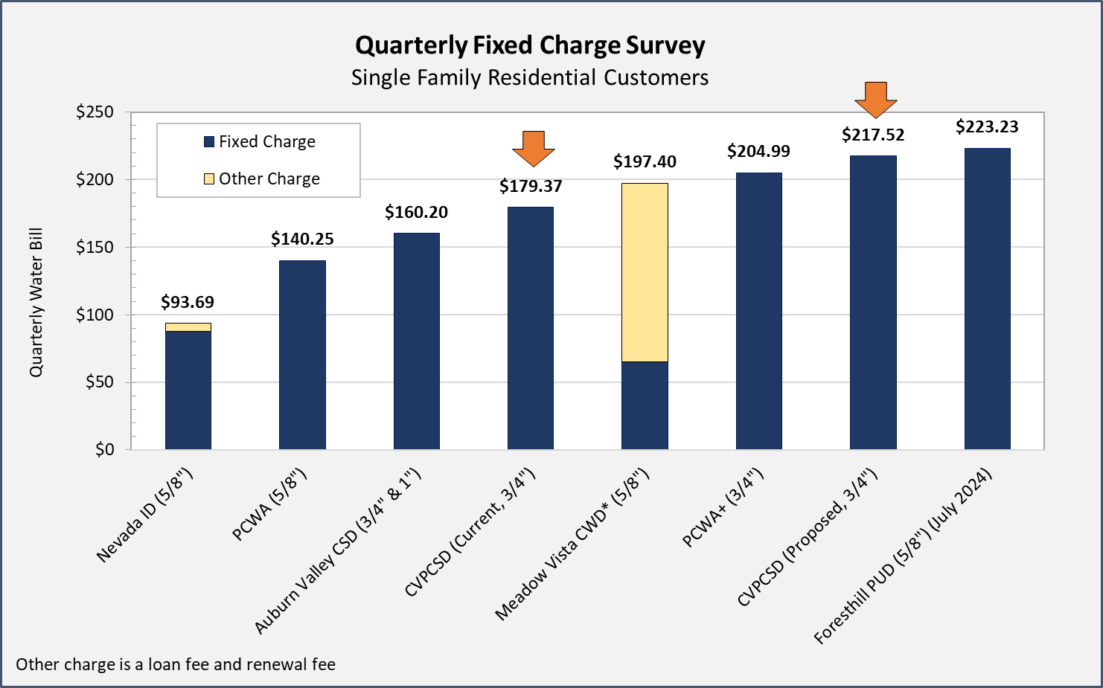
Fixed Charge Survey (current & FY25)

Slide 11
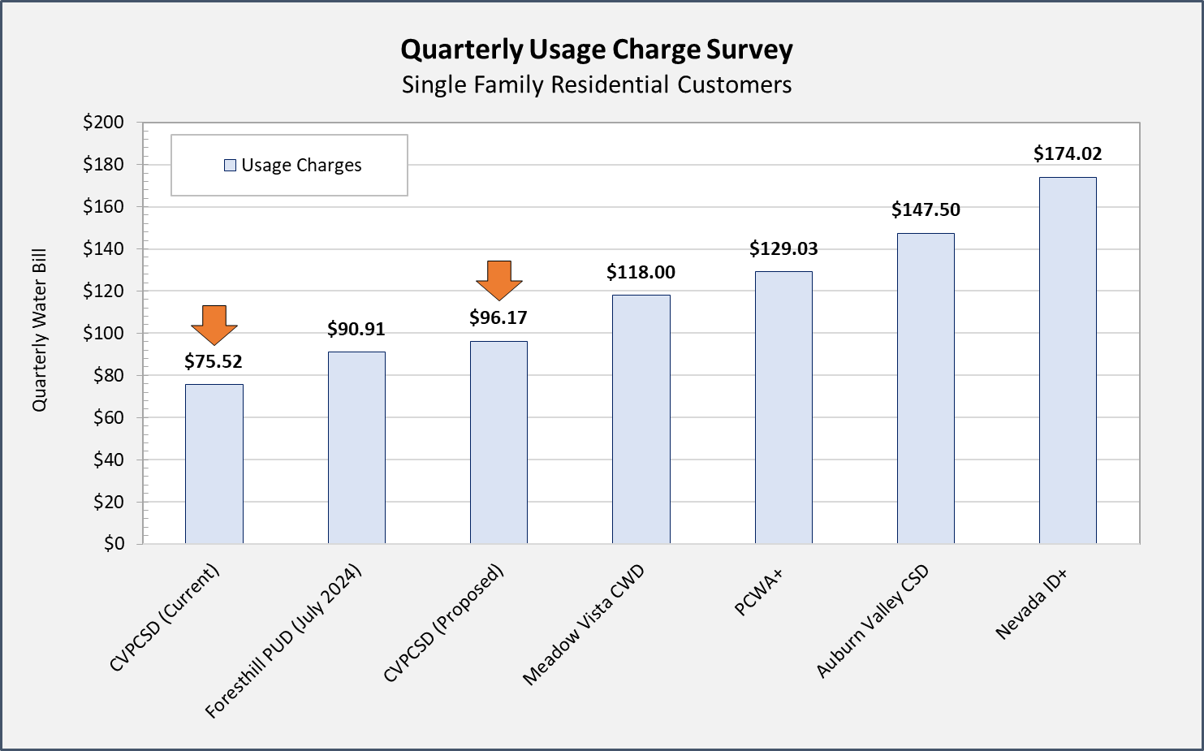
Usage Charge Survey (current & FY25)
+ Tiered water rate structure

Slide 12
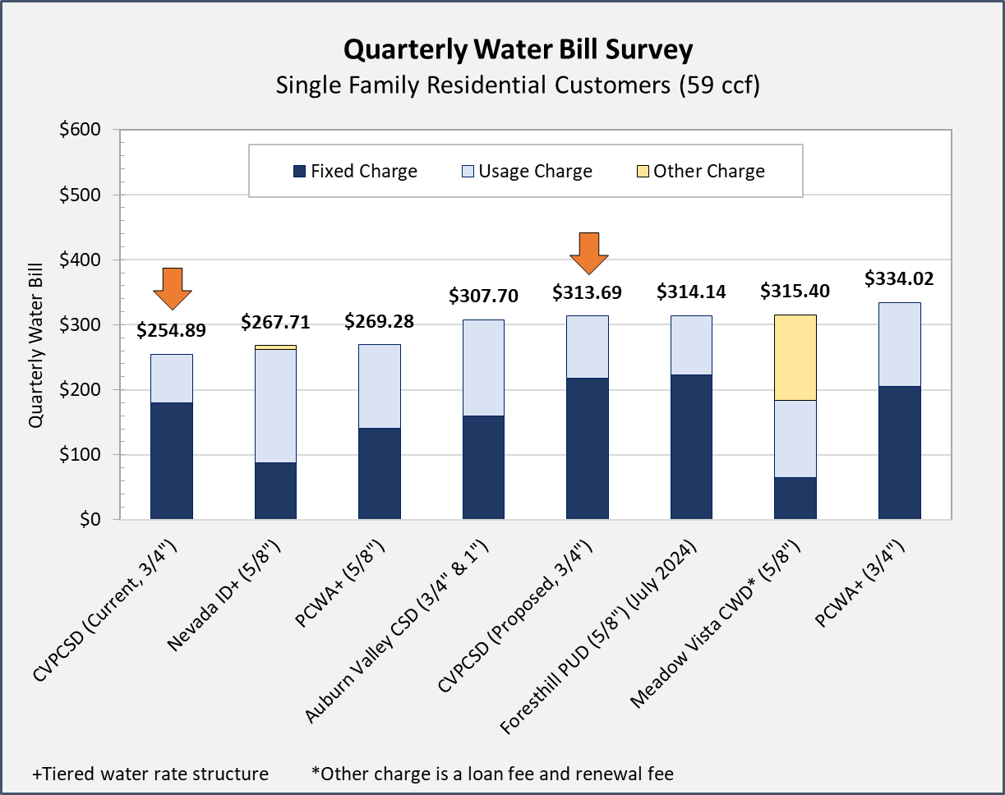
Water Rate Survey (current & FY25)

Slide 13
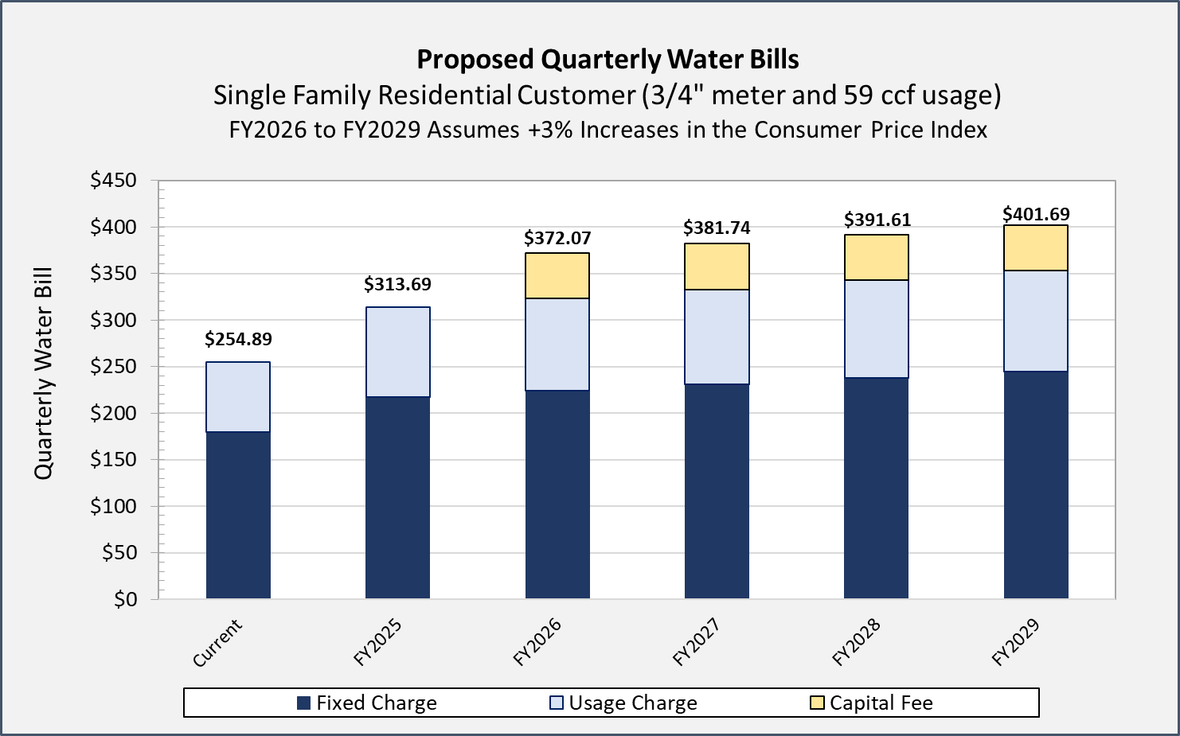
CVPCSD five year bill summary

Slide 14
Rate Plan Continued
July 1 of years 2025 to 2028
  The fixed and usage charges will be increased by the annual change in the Consumer Price Index (CPI), a common measure of inflation
  Minimum increase of 3% annually and a maximum increase of 10% (recommended for Prop 218 compliance so ratepayers know the potential high end of future charges)
  As inflation changes from year to year, the District’s cost of providing water service also increases such as the cost of chemicals, electricity, materials, and supplies
  The CPI increase is not intended to generate excess funds but instead keep up with actual costs to avoid future deficits

Slide 15
Tentative Rate Study Schedule
April 9: Present final report; Board votes to initiate Prop 218 process
April 26: Mail notice of public hearing w/ ratepayer outreach meeting info
Late April: internal meeting to plan for ratepayer outreach meeting
May 7: Ratepayer outreach meeting
June 11: Proposition 218 Public Hearing (47 days later)
July 1, 2024: New rates go into effect

Slide 16
Discussion

