Slide 1


CHRISTIAN VALLEY PARK
COMMUNITY SERVICES DISTRICT
Water Rate Study
Preliminary Recommendations
Board Meeting
February 13, 2024
Alison Lechowicz
Project Manager

Slide 2
Background
  Water service is self-supported by water rates
  Other revenues include hookup fees, standby fees, and interest
  Gayle Loop property taxes pay off the Gayle Loop debt
Rate study will cover a 5-year period
  First rate increase effective July 1, 2024
  Subsequent increases will go into effect on July 1 of 2025, 2026, 2027, 2028
  Provides water service to 632 customers
  District purchases raw water from the Placer County Water Agency (PCWA) and receives water from the Bowman canal system

Slide 3
Proposition 218
Governs how property-related charges are adopted
  Rates must be based on the reasonable cost of service
  Rates must proportionally recover costs based on how customers take service
  Revenues from rates can only be used for intended purpose
  Covers rates over a 5-year period
Procedural requirements:
  Conduct a rate study
  Mail a notice to property owners
  Hold a public hearing a minimum of 45 days after notice is mailed
  Rates cannot be adopted if more than 50% of ratepayers submit written protests

Slide 4
Current Quarterly Water Rates
Meter Size | Monthly Service Charge | Quarterly Service Charge
3/4" | $59.79 | $179.37
1" | $99.66 | $298.98
1-1/2" | $199.32 | $597.96
2" | $318.91 | $956.73
3" | $597.95 | $1,793.85
4" | $996.58 | $2,989.74
Usage Charge ($/ccf) | $1.28 | $1.28
1 ccf = 1 hundred cubic feet = 748 gallons

Slide 5
Tiered Water Rates – Not recommended
In 2015, Capistrano Taxpayers Association, Inc. v. City of San Juan Capistrano ruled that tiered water rates must be based on actual costs of providing water service to ratepayers
To comply with Prop 218,each water rate tier breakpoint (i.e. the consumption used in each tier) and the price of each tier must be individually cost-justified.
Higher use must be directly tied to specific costs such as imported water, higher electricity costs associated with peak pumping, increased maintenance, and/or conservation programs.
Tiers can no longer be assigned to customers solely based on conservation objectives. For example, public agencies may not arbitrarily raise the price of higher use tiers in order to offer a discount to lower water users.

Slide 6
Example Bills – ¾” Single Family
Quarter |  | Average Water Use (ccf) | Quarterly Bill
1 | Jan through Mar | 25 | $211.37
2 | Apr through Jun | 64 | $261.29
3 | Jul through Sep | 109 | $318.89
4 | Oct through Dec | 39 | $229.29
 | Average | 59 | $254.89

Slide 7
Water Fund Financial Overview
Strong estimated reserves at end of FY2024
Upcoming Cost of Service Increases
  Inflationary cost increases for most operating expenses
  +$14,000/year set aside for the USDA reserve requirement
  +$45,000/year in high priority capital projects (media replacements and valve replacements)
  Target a debt coverage ratio of 1.25x on existing Gayle Loop and USDA obligations to maintain a strong credit rating
Potential additional needed funding of $1M of pipe replacements
  Steel portion of the 8” Allen replacement
  6” Witt Road
Projected 2023/24 Financials
Approximately equal to the cost of the water line repair

Slide 8
Rate Options
Each +15% rate increase = about $100,000 in additional revenues
Proposed rates will be revised based on growth projections & Board discussion items
Options | Description | % Rate Increase
Option 1 – Base rate change | O&M and high priority capital | +15% rate increase
Option 2 – Gradual CIP funding | Cash fund $50,000 per year of pipe improvements | +23% rate increase
Option 3 – Fund $0.5M over 5 years | Cash fund $100,000 per year of pipe improvements | +30% rate increase
Option 4 – Fund $1M over 5 years | Cash fund $200,000 per year of pipe improvements | +46% rate increase

Slide 9
DRAFT Quarterly Water Rates

Slide 10
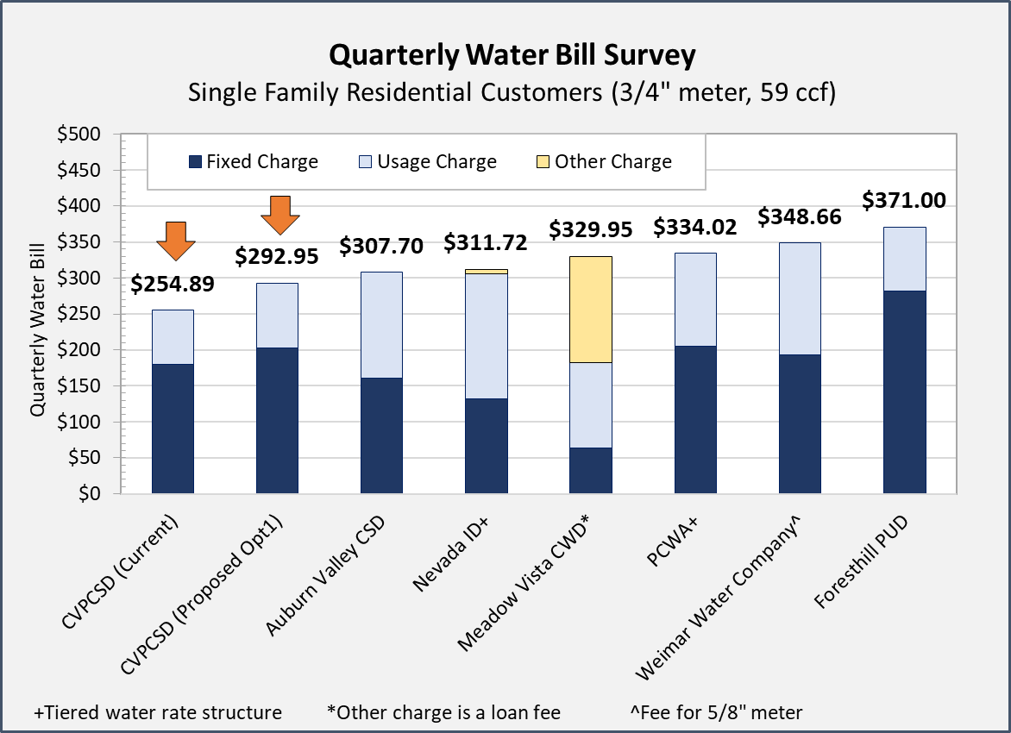
Water Rate Survey

Slide 11
Board Discussion Items
Growth Assumptions
  One new 1” meter added each year – pays hookups fees and rates
  260 unit apartment complex?
Treatment Plant Maintenance
  Budgeted expense is $19,000
  CVPCSD expects to go over-budget due to increased costs
  What level of maintenance should be included in the rate study?
Cost of water line breaks – does the District expect to fund $70,000 to $80,000 per year in expenses?
Capital improvement funding
  High priority only, some portion of pipeline replacements, or fully funded?
  All pay-go from rate revenues or would CVPCSD consider new debt?

Slide 12
Rate Study Schedule
February 13: Present initial recommendations to Board
March 12: Present revised recommendations to Board
April 9: Present final report; Board votes to initiate Prop 218 process
April 26: Mail notice of public hearing
June 12: Proposition 218 Public Hearing (at least 45 days later)
July 1, 2024: New rates go into effect

Slide 13
Questions?

